Slide 1

Introduction to algorithms what is an algorithm?
Lecture 1
23 September 2021

Slide 2
Module information
Module Title: Introduction to Algorithms
Module Code: CELEN086
Credits: 10
TOPICS:
Anatomy of an algorithm, pseudocode
Variables, Conditional statements, Boolean relations
Recursive algorithms
Data structures: Lists, Trees, Graphs

Slide 3
Module staff
Module Convenor: Dr Aidin Jalilzadeh
Lecturer and Seminar Tutor
Aidin Jalilzadeh
Email: aidin.jalilzadeh@nottingham.edu.cn
Office: TB322
Co-convenor and Seminar Tutor
Chenfei Zhang
Email: Chenfei.Zhang@nottingham.edu.cn
Office: TB312

Slide 4
timetable
Activity | Teaching weeks | Session | Room No.
Lectures | 2-13 | Thursday 15:00 – 16:00 | Siyuan Auditorium
Seminars | 3-13 | Check your individual streams

Slide 5
Assessment
Assessment Type | Weighting
Midterm test (10 NOV 2021) | 25%
Coursework project | 25%
Final written exam (2hrs) | 50%

Slide 6
seminars
Weekly 1hr sessions where you design and write algorithms – ATTENDANCE COMPULSORY!!
Problems will be presented to you in seminar class.
Bring pen and paper or anything that you can write on it. Hands on!!

Slide 7
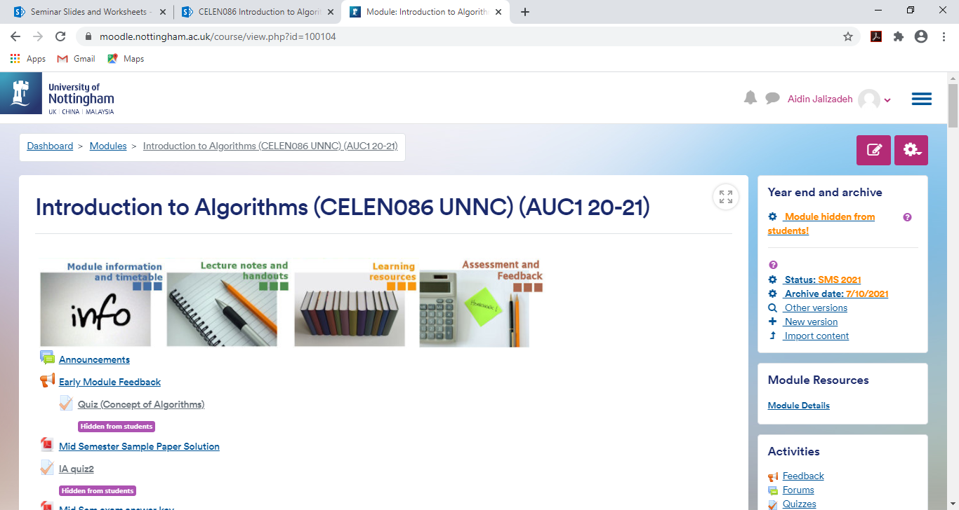
On moodle
Moodle is the virtual tool for communication with the class!
Log in using your University username and password – ENROL!
Course announcements
Lecture slides/Videos
You must check Moodle for updates at least once a day!

Slide 8
Recommended reference
Introduction to Algortihms by:
THOMAS H CORMEN
Some reading material
will be posted on Moodle

Slide 9
Plagiarism & collusion!!
The use of other people’s work and the intentional submission of it as though it was one’s own is regarded as plagiarism.
It is a serious academic offence and could result in termination of your University degree course.
Copying another student’s work is not only plagiarism, but it is educationally misguided.
The penalties and procedures associated with plagiarism are provided in a separate document (Student’s Handbook).
Discussion and working with colleagues and friends is often a productive way of studying and learning. However, Computer Science is a practical subject and to become proficient at it, you must work at the lectures, Seminar work sheets, and coursework.
Remember, you will be assessed (especially in examinations) on your ability and on what you understand.

Slide 10

What is an algorithm?
Recipe
Hungry?

Slide 11
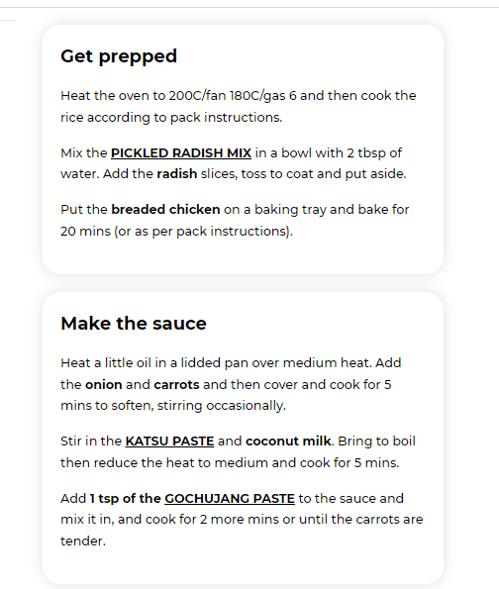
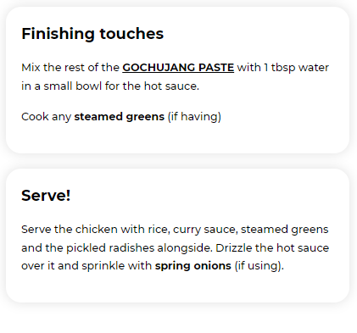

step by step
Recipe
1
3
2

Slide 12
algorithm
Algorithm is a step by step procedure for solving a specific problem or accomplishing a task.
The steps in any algorithm must be:
Well-defined: we must know what the task in hand is
Finite: it should stop (halt) when the task is achieved or if there is a logical error
Effective: means the steps will get us to the desired outcome

Slide 13
Algorithms are used everyday and everywhere
Online shopping
sorting and searching
Google search engine
data mining/sorting
Credit card transaction
Luhn algorithm
GPS route finding (e.g. Maps)
Finding the shortest/quickest route say for taxis

Slide 14

Efficiency/performance of an algorithm
Assembly guide
Minimum effort!
Minimum time!
Algorithm must be efficient!

Slide 15


12 coins problem
Given 12 identical gold coins, one of them is fake (lighter).
Use a balance scale to find the counterfeit coin.
Claim: we can determine the fake coin by using the scale only 3 times!
Fast scheme!
Algorithm: Divide & Conquer
A
=
Fake!!
B
A
B
C
C

Slide 16
Computational algorithms
In this course we will mainly be dealing with computational algorithms.
Using efficient algorithms to solve computational problems
Examples: finding the square root; finding prime numbers, finding max/min value of a list, …

Slide 17

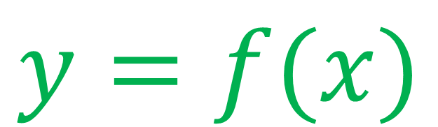

Computational procedures
$$x$$
$$y$$
function
algorithm
INPUT
OUT
PUT
Numerical value
String or character
Data structure (list)
$$y=f(x)$$
Numerical value
String or character
Data structure (list)

Slide 18
Anatomy of an algorithm
Algorithm Name (appropriate)
Requires: INPUT(s)
Returns: OUTPUT(S)
Header
Statement 1
Statement 2
.
.
.
return output(s)
End
Body of the algorithm
The statements are close to everyday language
i.e. not code language like C/C++ or python
The language of writing an algorithm is often referred to as pseudo-code means a fake code

Slide 19
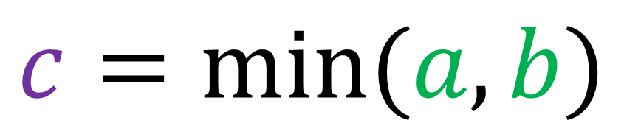
An easy algorithm – minimum of two numbers
Algo name
Algorithm 1: min(a,b)
Requires: two numbers a and b
Returns: the smallest of a and b
Input arguments
Input values
Output; just one value
Functional representation:
$$c=min⁡(a,b)$$
>> min(10,5)
>> 5

Slide 20
An easy algorithm – minimum of two numbers
USER
CPU
Algorithm 1: min(a,b)
Requires: two numbers a and b
Returns: the smallest of a and b
>> min(10,5)
1: if a < b then
2: return a
3: endif
4: if b < a then
5: return b
6: endif
7: END
a=10, b=5
Goto line 3
Goto line 4
Return 5

Slide 21
An easy algorithm – minimum of two numbers
good coding practice
Tracing an algorithm
with various input values
helps the programmer to
find errors and code bugs
To be sure that your
algorithm works perfectly
you must trace it with
different input arguments!!
CPU
USER
Algorithm 1: min(a,b)
Requires: two numbers a and b
Returns: the smallest of a and b
>> min(10,5)
>> 5
a=10, b=5
1: if a < b then
2: return a
3: endif
4: if b < a then
5: return b
6: endif
7: END
Tracking and Tracing
Goto line 3
Algorithm
Goto line 4
Return 5
Goto END

